Slide 1

Databases Overview, part I (day 3)
PROG102 – Marvin taboada

Slide 2
Database types
Commonly known types include:
Flat-file Databases
Hierarchical Databases
Relational Databases
Object Databases
NoSQL Databases
Document Databases
Key-Value Databases
Graph Databases

Slide 3
Relational Databases. SQL
Structured Query Language
Query types:
Data Definition Language (DDL)
Data Manipulation Language(DML)
Data Query Language(DQL)
Data Control Language (DCL)

Slide 4
Relational Databases. SQL Extensions
Microsoft SQL Server: Transact-SQL (T-SQL)
Oracle PL-SQL
…

Slide 5
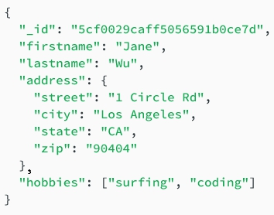
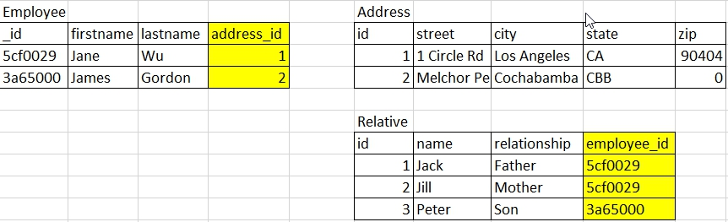
Relational Model Vs Object Model

